Slide 1
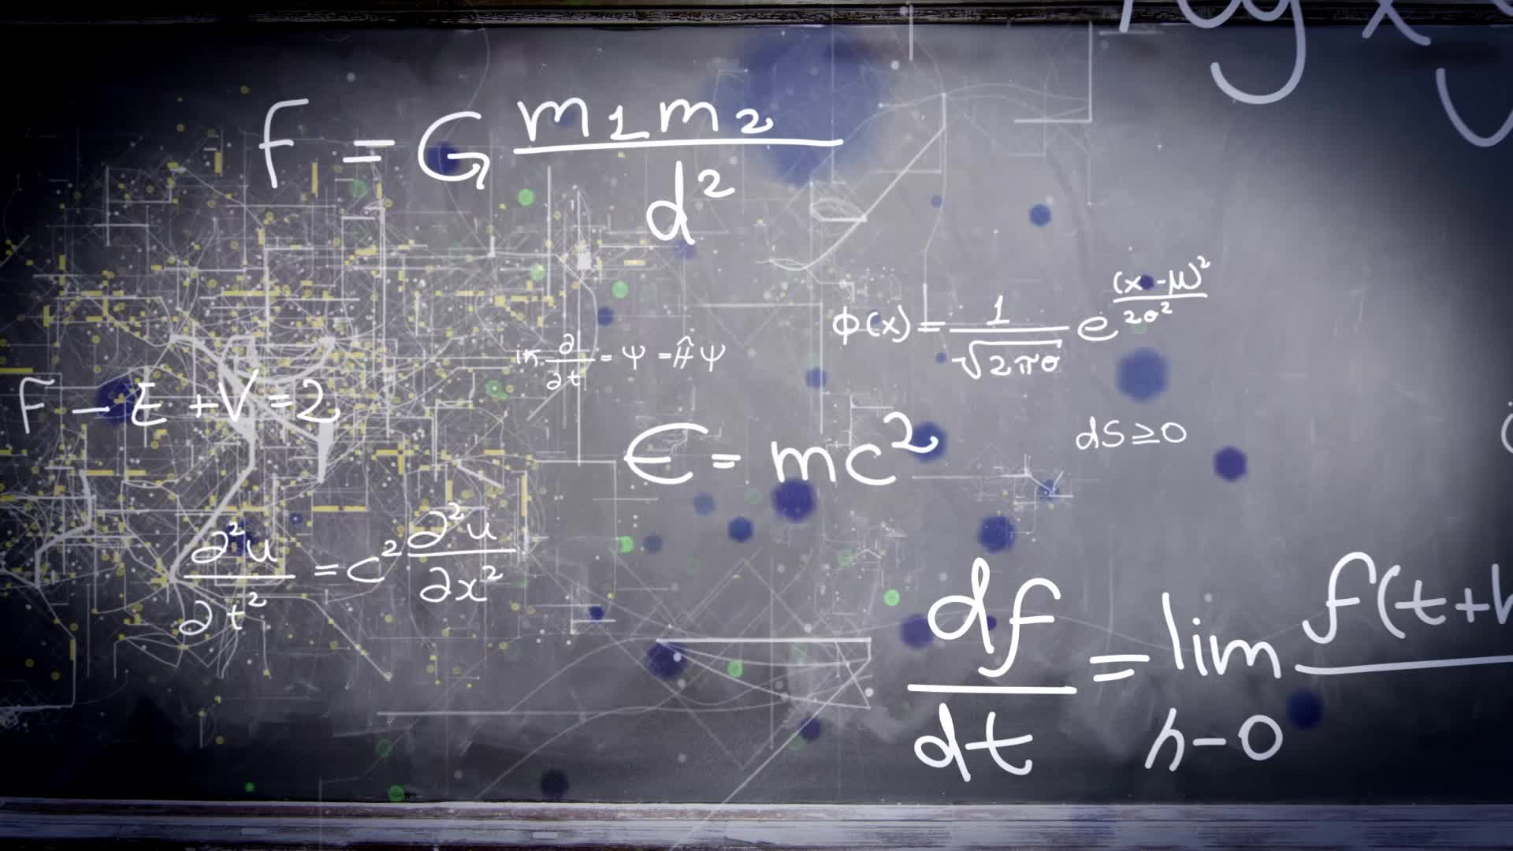
Chapter 3.5:
Limits At Infinity
HONORS CALCULUS/CALCULUS

Slide 2
LIMITS AT INFINITY
If $r$ is a positive rational number and c is any real number, then:
$$\lim_{x→∞}{\frac{c}{x^{r}}=0}$$
Furthermore, if $x^{r}$ is defined when $x<0$, then:
$$\lim_{x→∞}{\frac{c}{x^{r}}=0}$$
Creates a HORIZONAL ASYMPTOTE AT $y=0$

Slide 3
Ex. 1) $\lim_{x→∞}{(5−\frac{2}{x^{2}})}$
Ex. 2) $\lim_{x→∞}{(\frac{2x−1}{x+1})}$

Slide 4
Ex. 3)
A) $\lim_{x→∞}{(\frac{2x+5}{3x^{2}+1})}$
B) $\lim_{x→∞}{(\frac{2x^{2}+5}{3x^{2}+1})}$
C) $\lim_{x→∞}{(\frac{2x^{3}+5}{3x^{2}+1})}$

Slide 5
Ex. 3) Shortcut
A) $\lim_{x→∞}{(\frac{2x+5}{3x^{2}+1})}$
B) $\lim_{x→∞}{(\frac{2x^{2}+5}{3x^{2}+1})}$
C) $\lim_{x→∞}{(\frac{2x^{3}+5}{3x^{2}+1})}$

Slide 6
Ex. 4)
A) $\lim_{x→∞}\left(\frac{3x−2}{\sqrt{2x^{2}+1}}\right), x>0$
B) $\lim_{x→−∞}\left(\frac{3x−2}{\sqrt{2x^{2}+1}}\right), x<0$

Slide 7
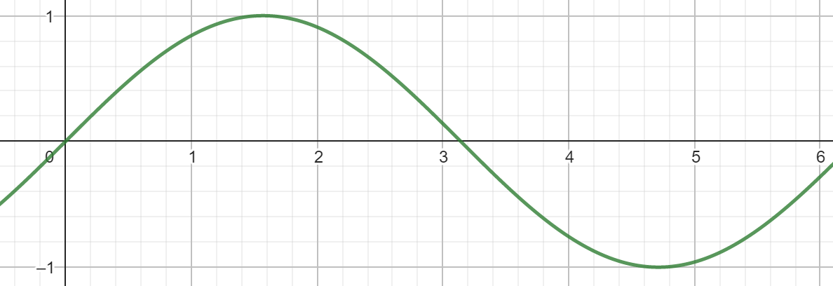
Ex. 5) $\lim_{x→∞}{sinx}$

Slide 8
The Squeeze Theorem
Ex. 6) $\lim_{x→∞}{\frac{sinx}{x}}$

